Slide 1
Kids’ Site Features
*Note: Contains a combination of 2019 & 2020 images
Website goes LIVE on June 15, 2020!
www.tdsummerreadingclub.ca

Slide 2
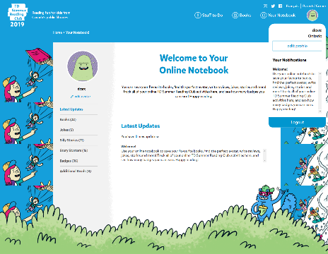
Create an Online Notebook
Notes:
Kids can generate web access codes directly on our website. This allows them to create their own digital notebooks and track their reading. Kids can personalize their notebooks with a nickname and avatar, and the notebook will store any contributions kids make to other parts of our website, such as jokes and stories.

Slide 3
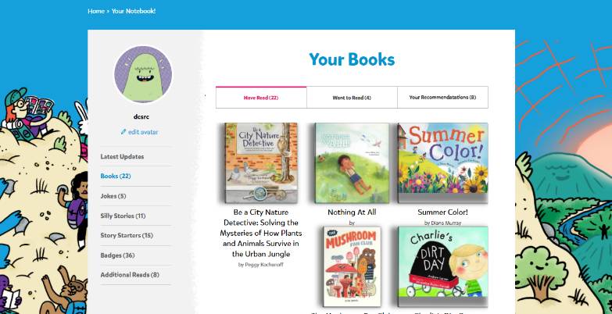
Your Notebook: Books
Notes:
Kids can add the books they have read, what they want to read and what they recommend.

Slide 4
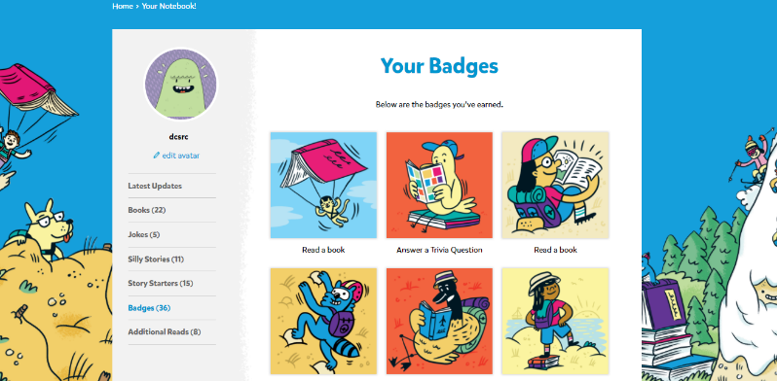
Your Notebook: Badges
Notes:
Each time a kid adds a book or submits content, such as reading a book or answering a trivia question, they are rewarded with a digital badge that is stored in their notebook.

Slide 5
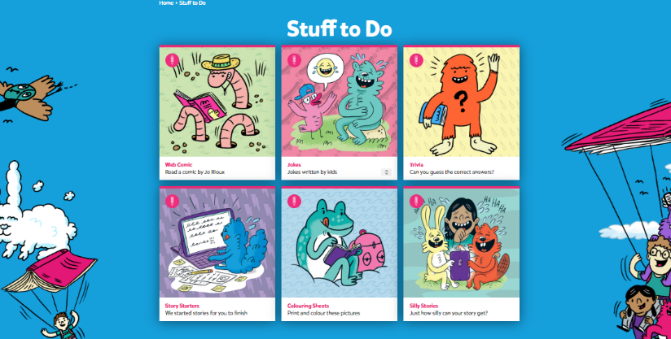
Stuff to Do
Notes:
There’s so many things to do! Read a web comic, read or write jokes, guess some trivia, help create some silly stories and do some colouring. We’ve also started some stories for kids to finish.

Slide 6
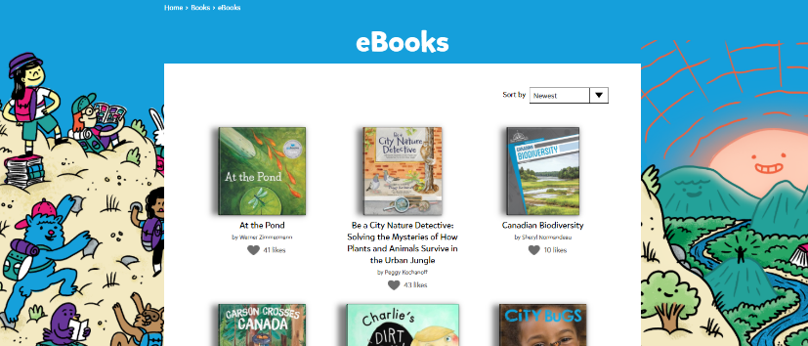
Read eBooks
Notes:
We have ebooks for all ages and interests, and in both English and French. Once kids set up their online notebooks, they can access the ebooks at any time over the summer—no waiting lists or restrictions!

Slide 7
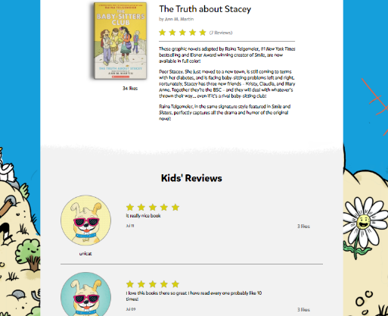
Review Books
Notes:
Kids can share what they think about books they have read for other kids to see.

Slide 8
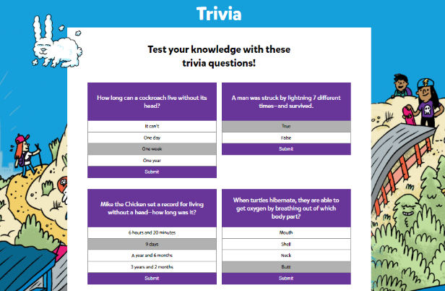
Trivia Questions
Notes:
Each week, we will have a new multiple choice trivia question for kids to answer. After selecting an answer, kids see an explanation and a prompt to explore the topic further.

Slide 9
Silly Stories
Notes:
Our silly stories ask kids to add their own words to a pre-written, hidden story. Once kids fill in the word prompts, the full story is revealed—and it’s usually silly!

Slide 10
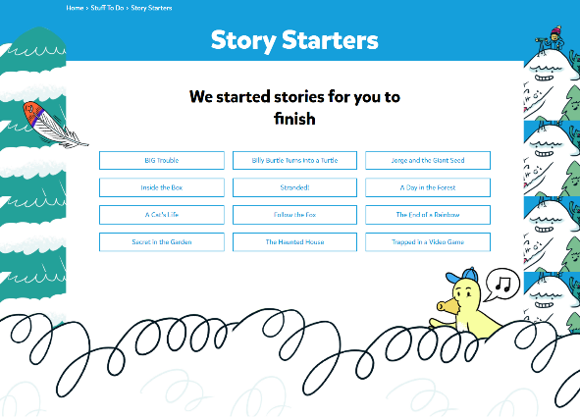
Story Starters
Notes:
We have story starters, where kids continue writing a story that we’ve started for them. Kids can also read the story endings that other kids have submitted.

Slide 11
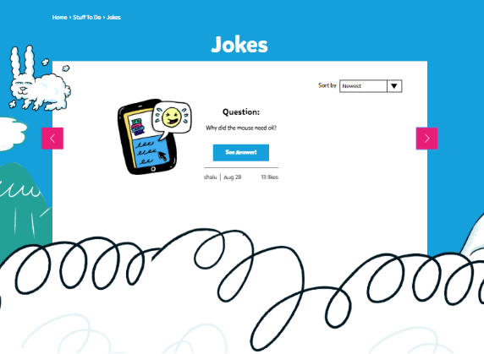
Read Jokes
Notes:
Kids can read jokes submitted by other kids. There is an option to like a joke and sort the jokes by most popular and trending.

Slide 12
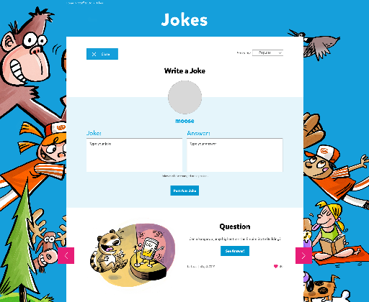
Write Jokes
Notes:
Kids can submit their own jokes, which will be posted to the site.

Slide 13
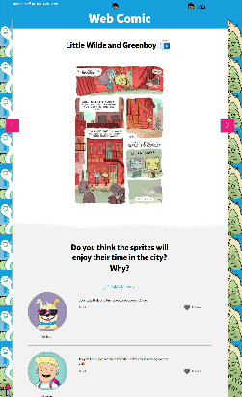
Web Comic
Notes:
Kean Soo has written an original web comic called The Transfer Student. Kids can read it and then participate in discussion questions with other kids. For bilingual kids, Yves Bourgelas has written an original web comic in French that they can check out as well.

Slide 14
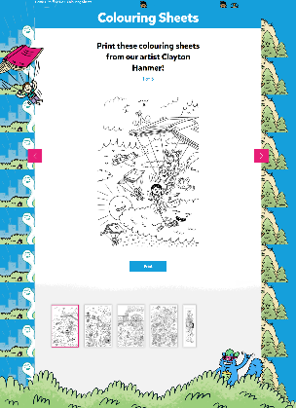
Colouring Sheets
Notes:
Colouring sheets ranging from simple to advanced for parents to print out for kids of all ages.

Slide 15
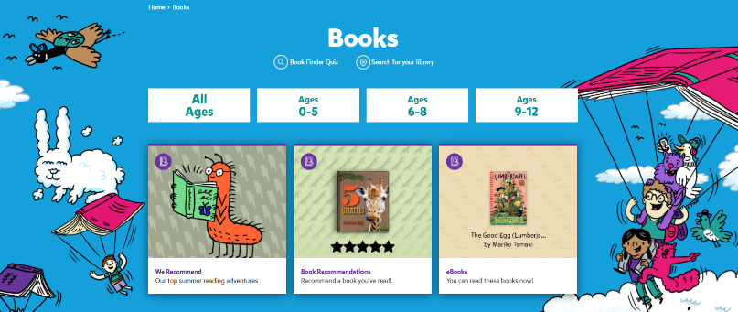
Find the Perfect Book
Notes:
Kids answer our book-finder questions to find the book most suited to them.

Slide 16
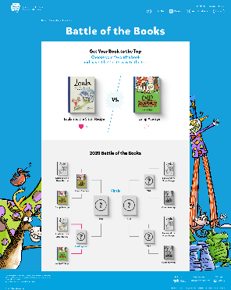
NEW! Battle of the Books
Notes:
Vote in the Battle of the Books! This is an 8-book tournament in which two books battle for top choice each week. All of the books are available as ebooks, so kids can read the books online and then vote for their favourite. At the end of the summer one book will be crowned as the summer’s champion.

Slide 17
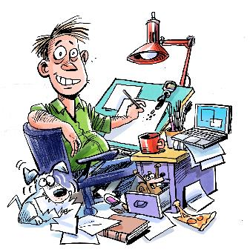
NEW! Author/Illustrator Readings & Workshops
Notes:
We will be offering 28 online readings and workshops that can be accessed through the Kids’ Site, including videos from Dave Whamond, Kean Soo and Yves Bourgelas.

Slide 18
More Information
Keep up-to-date with TD SRC news! Scroll to the bottom of the NEWS page and sign up for email updates by subscribing to our newsletter.
https://www.tdsummerreadingclub.ca/staff/news
If you have any questions or need clarification, please don’t hesitate to get in touch with us:
Program Development
Jessica Roy
Manager, TD Summer Reading Club
416-393-7519
jessicaroy@tpl.ca
Daniel Colangelo
Senior Services Specialist
416-393-7507
dcolangelo@tpl.ca
National Program Coordination
Lianne Fortin
Program Manager, Library and Archives Canada
613-552-3568
lianne.fortin@canada.ca

